Slide 1
Search Algorithms
Efficiency and Analysis

Slide 2
Algorithm selection
Algorithms are ordered lists of steps for solving a problem
Algorithms are also abstractions of the programming process
Often there are many different algorithms for solving the same problem

Slide 3
Algorithms: main considerations
How fast will it run
How much memory will it use
How easy is it to implement
The choice depends on the software
  It may mean your algorithm is not the most efficient

Slide 4
Program efficiency
Computer scientists analyze algorithms for their efficiency
  In a machine independent manner
  By focussing on the critical operations performed
  Like the number of comparisons
    (for sorting routines)

Slide 5
Rate of growth
The most important aspect of algorithm efficiency
Two algorithms may be just as efficient for small data sets but differ greatly for large ones.

Slide 6
Asymptotic Efficiency
The asymptotic efficiency of an algorithm
  describes its relative efficiency as n gets very large.
Often called the “order of complexity”
“Big O” - O()
Example: Sequential search is O(n)

Slide 7
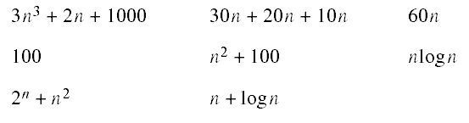
Exercise
  Rank the asymptotic orders of the following functions, from highest to lowest.
    (You may wish to graph some or all of them.)

Slide 8
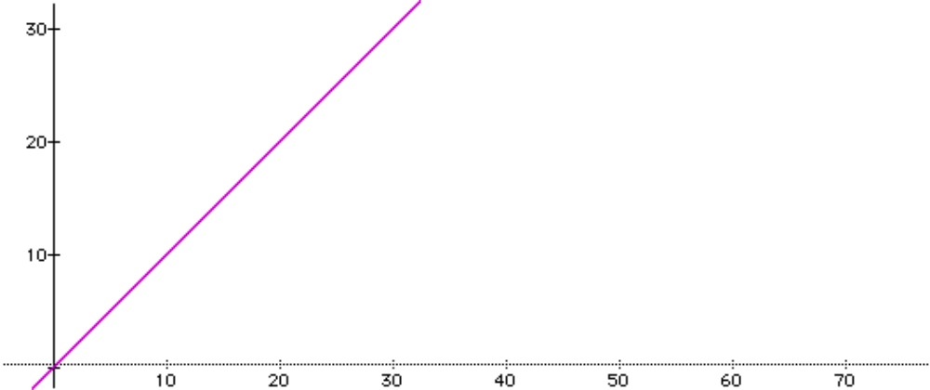

Slide 9
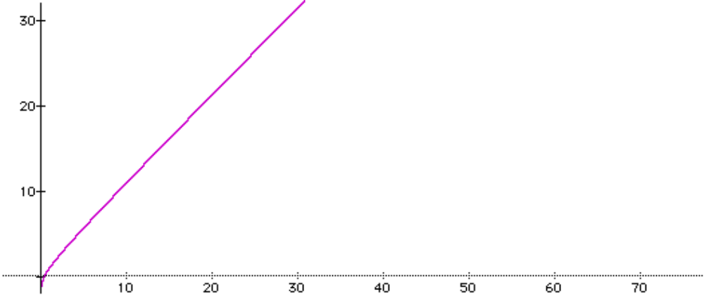


Slide 10
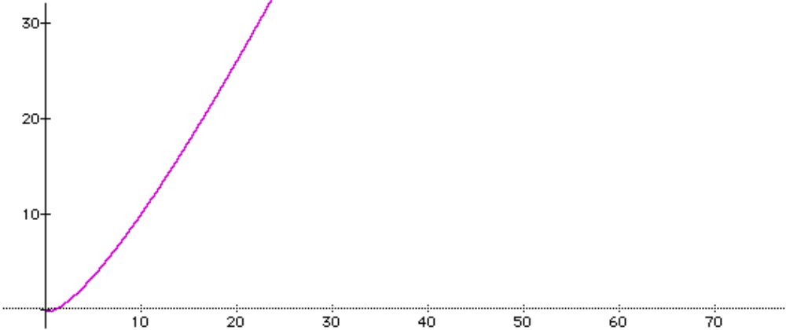


Slide 11
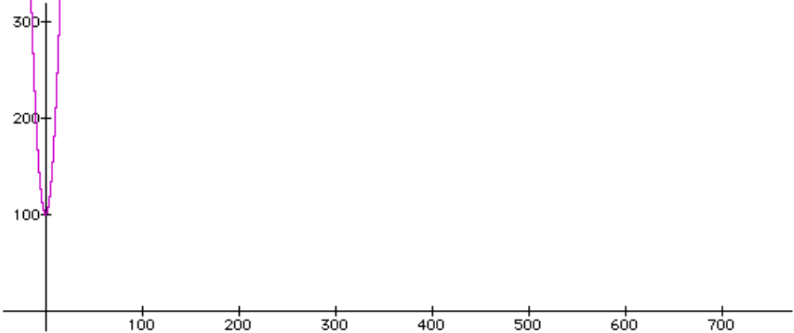


Slide 12
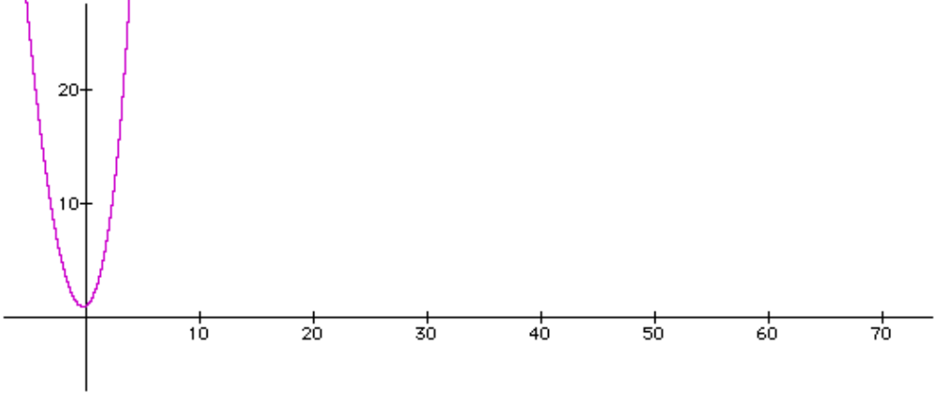
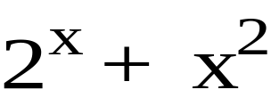

Slide 13
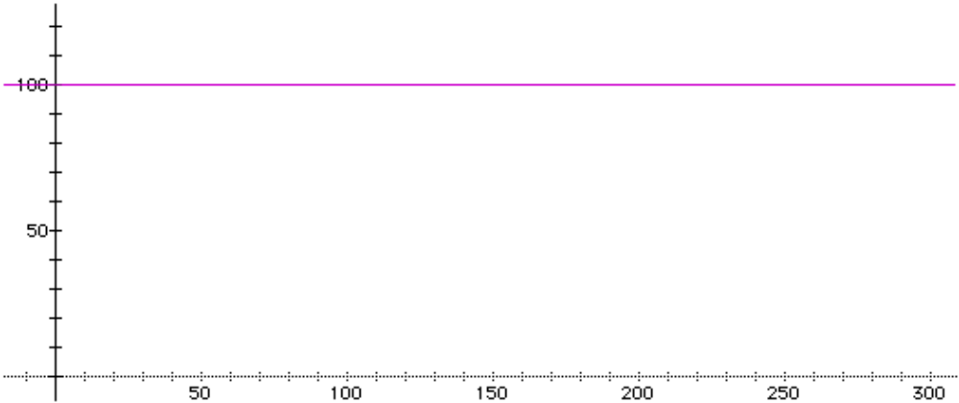


Slide 14
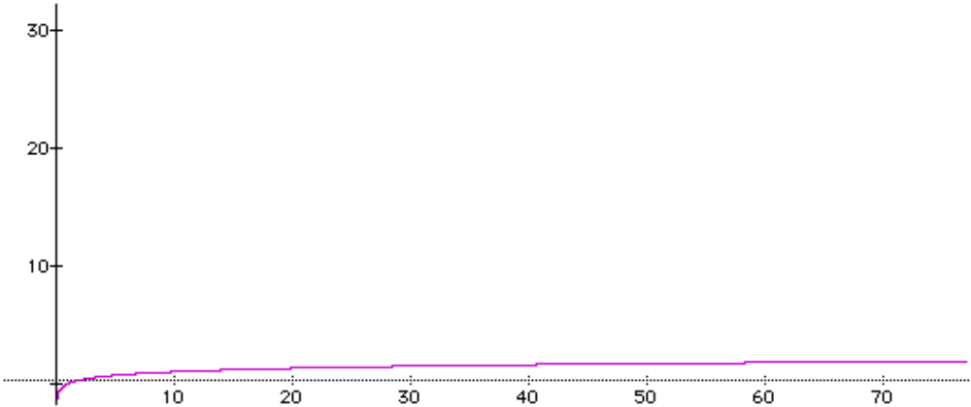


Slide 15
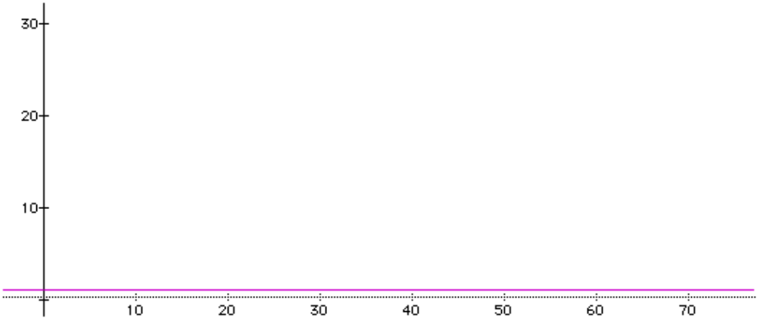


Slide 16
Analyzing the Linear Search
Assumes a list of n elements
Assumes a search key
A linear search looks for the target key value by proceeding in sequential fashion through the list

Slide 17
Sample record format
key
data

Slide 18
Linear Search algorithm
For each item in the list
if the item’s key matches the target,
stop and report “success”
Report “failure”

Slide 19
Linear Search
int linearSearch(int a[], int n, int target)
{
int i;
for (i = 0; i < n; i++)
if (a[i] == target) // key comparison
return i;
return -1; // use -1 to indicate failure
}

Slide 20
Analysis
Speed of an algorithm is measured by counting key comparisons
Best case is 1 comparison
Worst case is n comparisons
Average case is n/2 comparisons
  if the target is in the list

Slide 21
Analysis (continued)
What if the target we are looking for has only a 50% chance of being in the list.
The complexity must account for both targets that can be found and targets that cannot.
For targets that can be found it is n/2
For targets that cannot be found it is n
For targets that can be found only 50% of the time it is: 1/2*n/2 (found) + 1/2*n (not found)
The order of complexity therefore is: n/4 + n/2 = 3n/4

Slide 22
Polynomial expressions
All polynomial equations are made up of a set of terms.
Usually with coefficients and exponents
The fastest growing term is called the term of the “highest order”
A linear search, like the last example, has only one term to describe it: 3n/4
This can be written as (3/4)n
3/4 is the coefficient, n is the exponent
n is also the highest order term

Slide 23
From polynomials to Big-O
A linear function is one whose growth is tied to n
In other words, n is the highest order polynomial
The growth of the expression is tied to the highest order term and is called the “order of magnitude”
Order of magnitude is expressed as Big-O
For linear functions, Big-O is n
We express this as O(n)
To find out what the order of an expression is, look for the highest order term.

Slide 24
Graphing Big-O
The x axis corresponds to the number of elements in the list
The y axis is the number of critical operations required by an algorithm
The order of complexity is the highest order term in the analysis because it is the one that increases the fastest
Constant multipliers are ignored
Example: n+100 is graphed as O(n)
For a linear search n/2 is also O(n)
Similarly, from last example, 3n/4 is O(n)

Slide 25
Binary Search
Repeatedly divides the list in half and in half again
The result is a great improvement on linear searching
What is the asymptotic efficiency?
  Best case is 1 comparison
  Worst case is log₂ n
Logarithmic complexity is much faster than linear
  Even if we use the worst case

Slide 26
Binary search strategy
A[0] [1] [2] [3] [4] [5] [6] [7] [8] [9] [10] [11][12] [13][14] [15][16] [17]
10 14 15 20 23 25 26 27 31 32 34 37 41 42 44 45 46 49
A[mid]
Searching for 26

Slide 27
Binary search strategy
A[0] [1] [2] [3] [4] [5] [6] [7] [8] [9] [10] [11][12] [13][14] [15][16] [17]
10 14 15 20 23 25 26 27 31 32 34 37 41 42 44 45 46 49
A[mid]
Searching for 26

Slide 28
Binary search strategy
A[0] [1] [2] [3] [4] [5] [6] [7] [8] [9] [10] [11][12] [13][14] [15][16] [17]
10 14 15 20 23 25 26 27 31 32 34 37 41 42 44 45 46 49
A[mid]
Searching for 26

Slide 29
Binary search strategy
A[0] [1] [2] [3] [4] [5] [6] [7] [8] [9] [10] [11][12] [13][14] [15][16] [17]
10 14 15 20 23 25 26 27 31 32 34 37 41 42 44 45 46 49
A[mid]
Searching for 26

Slide 30
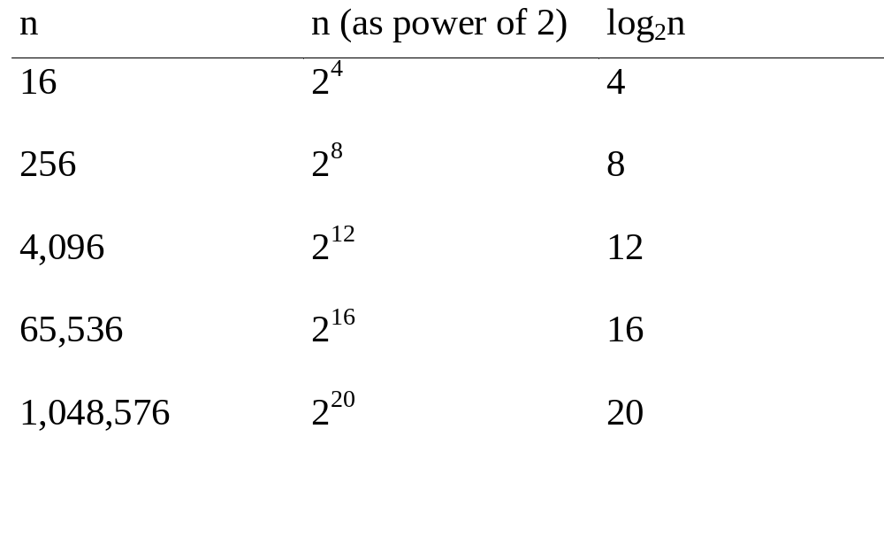
The growth of the base-2 log function

Slide 31
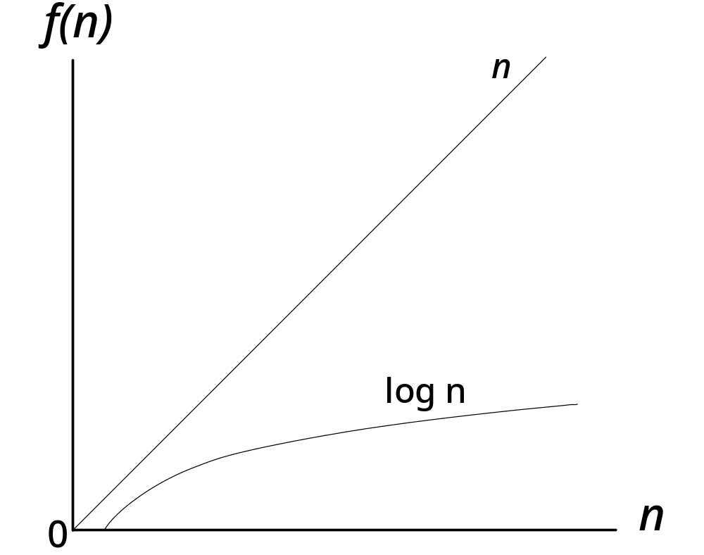
Graph illustrating relative growth of linear and logarithmic functions

Slide 32
Defective Binary Search
int binarySearch(int a[], int n, int target)
{ // Precondition: array a is sorted in ascending order from a[0] to a[n-1]
int first(0), last(n - 1), int mid;
while (first <= last) {
mid = (first + last)/2;
if (target == a[mid])
return mid;
else if (target < a[mid])
last = mid;
else // must be that target > a[mid]
first = mid; }
return -1; // use -1 to indicate item not found
}

Slide 33
Binary search strategy
A[0] [1] [2] [3] [4] [5] [6] [7] [8] [9] [10] [11][12] [13][14] [15][16] [17]
10 14 15 20 23 25 26 27 31 32 34 37 41 42 44 45 46 49
First
0
Last
17
A[mid]
8
Searching for 26

Slide 34
Binary search strategy
A[0] [1] [2] [3] [4] [5] [6] [7] [8] [9] [10] [11][12] [13][14] [15][16] [17]
10 14 15 20 23 25 26 27 31 32 34 37 41 42 44 45 46 49
First
0
Last
8
A[mid]
4
Searching for 26

Slide 35
Binary search strategy
A[0] [1] [2] [3] [4] [5] [6] [7] [8] [9] [10] [11][12] [13][14] [15][16] [17]
10 14 15 20 23 25 26 27 31 32 34 37 41 42 44 45 46 49
First
4
Last
8
A[mid]
6
Searching for 26

Slide 36
Problem
This code works fine for finding an item that is contained in the list.
However, it does not work so well if the item is not in the list.
We get an infinite loop in that case.

Slide 37
Binary search strategy
A[0] [1] [2] [3] [4] [5] [6] [7] [8] [9] [10] [11][12] [13][14] [15][16] [17]
10 14 15 20 23 25 26 27 31 32 34 37 41 42 44 45 46 49
First
0
Last
17
Searching for 24
A[mid]
8

Slide 38
Binary search strategy
A[0] [1] [2] [3] [4] [5] [6] [7] [8] [9] [10] [11][12] [13][14] [15][16] [17]
10 14 15 20 23 25 26 27 31 32 34 37 41 42 44 45 46 49
First
0
Last
8
Searching for 24
A[mid]
4

Slide 39
Binary search strategy
A[0] [1] [2] [3] [4] [5] [6] [7] [8] [9] [10] [11][12] [13][14] [15][16] [17]
10 14 15 20 23 25 26 27 31 32 34 37 41 42 44 45 46 49
First
4
Last
8
Searching for 24
A[mid]
6

Slide 40
Binary search strategy
A[0] [1] [2] [3] [4] [5] [6] [7] [8] [9] [10] [11][12] [13][14] [15][16] [17]
10 14 15 20 23 25 26 27 31 32 34 37 41 42 44 45 46 49
First
4
Last
6
Searching for 24
A[mid]
5

Slide 41
Binary search strategy
A[0] [1] [2] [3] [4] [5] [6] [7] [8] [9] [10] [11][12] [13][14] [15][16] [17]
10 14 15 20 23 25 26 27 31 32 34 37 41 42 44 45 46 49
First
4
Last
5
Searching for 24
WE ARE NOW STUCK
HERE FOREVER!!
A[mid]
4

Slide 42
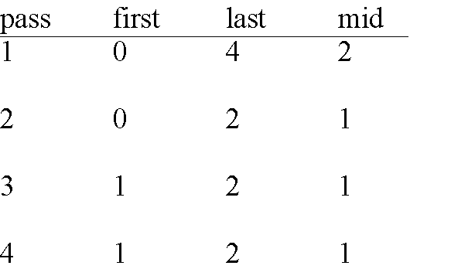
Trace of Code Example 5-2

Slide 43
Verified Binary Search
int binarySearch(int a[], int n, int target)
{
// Precondition: array a is sorted in ascending order
// from a[0] to a[n-1]
int first(0); int last(n - 1); int mid;
while (first <= last) {
mid = (first + last)/2;
if (target == a[mid])
return mid;
else if (target < a[mid])
last = mid - 1;
else // must be that target > a[mid]
first = mid + 1;
}
return -1; //use -1 to indicate item not found
}

Slide 44
Binary search strategy
A[0] [1] [2] [3] [4] [5] [6] [7] [8] [9] [10] [11][12] [13][14] [15][16] [17]
10 14 15 20 23 25 26 27 31 32 34 37 41 42 44 45 46 49
First
0
Last
17
Searching for 24
A[mid]
8

Slide 45
Binary search strategy
A[0] [1] [2] [3] [4] [5] [6] [7] [8] [9] [10] [11][12] [13][14] [15][16] [17]
10 14 15 20 23 25 26 27 31 32 34 37 41 42 44 45 46 49
First
0
Last
7
Searching for 24
A[mid]
4

Slide 46
Binary search strategy
A[0] [1] [2] [3] [4] [5] [6] [7] [8] [9] [10] [11][12] [13][14] [15][16] [17]
10 14 15 20 23 25 26 27 31 32 34 37 41 42 44 45 46 49
Last
7
First
5
Searching for 24
A[mid]
6

Slide 47
Binary search strategy
A[0] [1] [2] [3] [4] [5] [6] [7] [8] [9] [10] [11][12] [13][14] [15][16] [17]
10 14 15 20 23 25 26 27 31 32 34 37 41 42 44 45 46 49
First
5
Last
5
Searching for 24
A[mid]
5

Slide 48
Binary search strategy
A[0] [1] [2] [3] [4] [5] [6] [7] [8] [9] [10] [11][12] [13][14] [15][16] [17]
10 14 15 20 23 25 26 27 31 32 34 37 41 42 44 45 46 49
First
5
Last
4
Searching for 24
PROGRAM TERMINATES
WHEN first > last
A[mid]
5

Slide 49
Retrieval by key
A common programming task is to look up an item in a list
We have already seen some simple ways of doing this
  Linear search
  Binary search
They differ in terms of data requirements and search efficiency

Slide 50
Hashing
Hashing is the process of turning the
key value into an integer pointer, used
to locate a storage location in a larger array.
Hash codes should be designed to give
different codes for different keys, although,
this cannot be guaranteed.

Slide 51
Hashing
Hashing is a technique that enables searching the data with a complexity O(1).
Using a key (index) value for each a data record, the key value can be used to represent an array index that is used for data insertion (no sorting time) and retrieval (no search time).
The challenge in this design is to define a mapping function between the stored record data and the key/index value. Such a mapping function is called hash function.

Slide 52
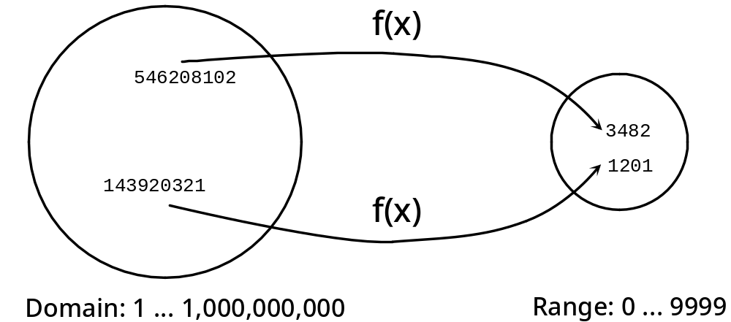
Hash Function Map

Slide 53
An example of hash conversion
You wish to store product information by product number. The product numbers have 5 digits with the lowest one being 10000.
const int max_size = 10000;
Then we could come up with a simple hash function
hashKey = productCode – max_Size;
This gives us a number between 0 and 9999.
We can use this unique number to directly access the array element containing data for that product.

Slide 54
Product code hash example
0
Product: Widget
Product code: 11234
ProductArray[11234 - 10000]
1
.
.
.
widget
1234
.
.
.
.
9998
9999

Slide 55
Another implementation
0
Or, we could use mod (%)
like this:
1
.
.
.
Product: Widget
Product code: 11234
ProductArray[11234 % 10000]
widget
1234
.
.
.
.
9998
9999

Slide 56
An internet example
Internet Protocol (IP) uses 32-bit addresses to look up host names.
Example: 63.100.1.17 (4 bytes)
When you want to access a host machine that is not on your network the router takes the host name you give it and looks up the IP address.
It then forwards your request to that host computer.

Slide 57
Problem
Routers need to look up addresses as quickly as possible.
There are millions of IP addresses, so how will it do this?
Linear search? O(n)
Binary search? O(log₂n)
Neither of these are fast enough.

Slide 58
Answer
Convert the host name “www.cnn.com” to it’s IP address using a hash function based on the characters.
Perhaps we could use ASCII codes to generate unique numbers within a certain range.

Slide 59
Issues in hashing
Each hash should generate a unique number. If two different items produce the same hash code we have a collision in the data structure. Then what?
Two issues must be addressed
  1. Hash functions must minimize collisions (there are strategies to do this)
  2. If (when) collisions do occur, we must know how to handle them.

Slide 60
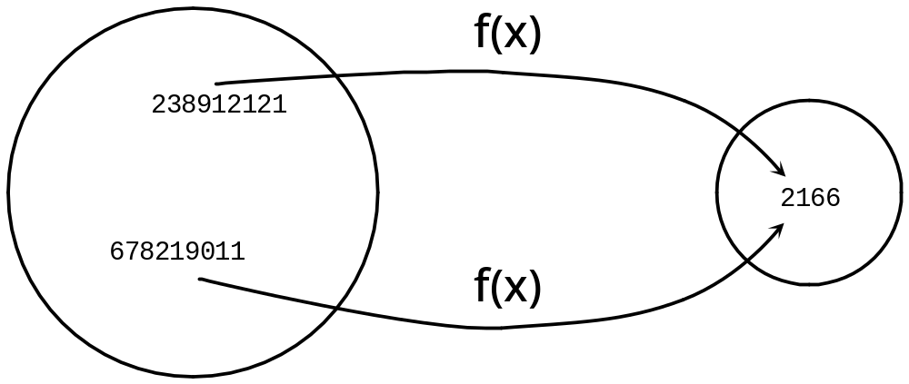
A Collision

Slide 61
What if...
0
We used mod (%) like
this:
1
.
.
.
Product: Widget
Product code: 11234
Product: Whatzit
Product code: 12234
ProductArray[11234 % 1000]
widget
234
.
whatzit
.
.
.
998
999

Slide 62
Two good rules to follow
A good hashing function must
  1. Always produce the same address for a given key, and
  2. For two different keys, the probability of producing the same address must be low.

Slide 63
Collision
Same hash value for two different records.
Generally, a collision-free hash function is not easy to design.
  A usual approach is to use an array size that is larger than needed. The extra array positions make the collisions less likely
  A good hash function will distribute the keys uniformly throughout the locations of the array.

Slide 64
Collison Resolution
One way to resolve collisions is to place the colliding record in another location that is still open.
  Open-addressing collision resolution techniques
    Linear probing
    double hashing
Chained hashing collision resolution techniques

Slide 65
Open Addressing
Open addressing requires that the array be initialized so that the program can test if an array position already contains a record.
  A mechanism is required to determine the next array index to be searched.
    Linear Probing
    Double Hashing

Slide 66
Linear Probing
if hash(x) is full check for [hash(x) + 1].
  A common problem with linear probing is clustering
  Clustering makes insertions take longer because the insert function must step all the way through a cluster to find a vacant location. Searches require more time for the same reason.

Slide 67
Hash table after 365 added
0
3
3
0
1
1. can't add 365 at its home address
2
3
2
1
3
4
9
8
2. so probe forward, adding it
4
3
6
5
at the next free slot
5
6
7
8
4
1
5
9
1
0
7
9
1

Slide 68
Hash table after 659 added
0
3
3
0
2. wrapping around, next
1
6
5
9
free space found here
2
3
2
1
3
4
9
8
4
3
6
5
5
6
7
8
4
1
9
1. can't add 659 at its home address
1
0
7
9
1

Slide 69
Double Hashing
Double Hashing is the most common technique to avoid clustering.
Let i = hash(key).
  If the location data[i] already contains a record then let i = (i+hash2(key)) and try the new data[i].
  If that location already contains a record, then let i = (i+hash2(key)), and try that data[i], and so forth until a vacant position is found.

Slide 70
Chained Hashing
In open addressing, each array element can hold just one entry. When the array is full, no more records can be added to the table.
A better approach is called chained hashing
  Each component of the hash table's array can hold more than one entry.
We still hash the key of each entry, but upon collision, we simply place the new entry in its proper array component along with other entries that happened to hash to the same array index.
The most common way to implement chaining is to have each array element be a linked list. The nodes in a particular linked list will each have a key that hashes to the same value.

Slide 71
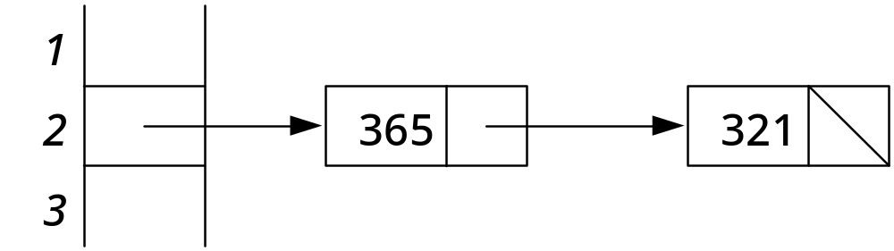
Chained Hashing

Slide 72
Hash table class definition
template < class tableKeyType, class tableDataType >
class Table
{ public:
Table(); // Table constructor
void insert(const tableKeyType & key, const tableDataType & data);
// Precondition: None
// Postcondition: data and key are stored in the Table,
// i.e., lookup(key,data) == true and returns the data
// Note: If data already stored with this key, the insert
// call will replace it.

Slide 73
Public section (continued)
bool lookup(const tableKeyType & key,
tableDataType & data);
// Precondition: None
// Postcondition: if key in table, returns true and associated
// data is returned; otherwise, false is returned and
// data is undefined.
void deleteKey(const tableKeyType & key);
// Precondition: None
// Postcondition: lookup(key,d) returns false
void dump(); // print the contents of the hash table

Slide 74
Private section
private:
// implementation via a hash table
struct Slot;
typedef Slot * Link;
struct Slot {
tableKeyType key;
tableDataType data;
Link next;
};
Link T[MAX_TABLE]; // table is an array of pointers to slots

Slide 75
Private section (continued)
int hash(const tableKeyType & key);
// Precondition: none
// Postcondition: none
// Returns: the home address for key
bool search(Link & slotPointer, const tableKeyType & target);
// Precondition: slotPointer points to the start of the chain
// for target's hash address
// Postcondition: if target is in the chain, slotPointer points to it
// Returns: true if target is in the table, else false
};

Slide 76
hash() implementation
template < class tableKeyType, class tableDataType >
int
Table < tableKeyType, tableDataType >
::hash(const tableKeyType & key)
{
return key % MAX_TABLE;
}

Slide 77
Search() implementation
template < class tableKeyType, class tableDataType >
bool Table < tableKeyType, tableDataType >
::search(Link & slotPointer, const tableKeyType & target)
{
// search for target, starting at slotPointer
for ( ; slotPointer; slotPointer = slotPointer -> next)
if (slotPointer->key == target)
return true;
return false;
}

Slide 78
Table constructor
template < class tableKeyType, class tableDataType >
Table < tableKeyType, tableDataType >
::Table() // implementation of Table constructor
{ int i;
for (i = 0; i < MAX_TABLE; i++)
T[i] = 0;
}

Slide 79
Insert() implementation
template < class tableKeyType, class tableDataType >
void Table < tableKeyType, tableDataType >
::insert(const tableKeyType & key, const tableDataType & data)
{ int pos(hash(key)); // find a position to insert the item
Link sp(T[pos]);

Slide 80
Insert() continued
if (!search(sp, key)) { // key was not in the table
// insert new item at beginning of list
Link insertedSlot = new Slot;
insertedSlot->key = key;
insertedSlot->data = data;
insertedSlot->next = T[pos];
T[pos] = insertedSlot;
}
else // found old record -- update the data
sp->data = data;
}

Slide 81
lookup() implementation
template < class tableKeyType, class tableDataType >
bool Table < tableKeyType, tableDataType >
::lookup(const tableKeyType & key, tableDataType & data)
{ int pos(hash(key));
Link sp(T[pos]);
if (search(sp, key)) {
data = sp->data;
return true; }
else
return false;
}

Slide 82
deleteKey() implementation
template < class tableKeyType, class tableDataType >
void
Table < tableKeyType, tableDataType >::deleteKey(const tableKeyType & key)
{ // need to find pointer to item preceding the slot to delete
int pos(hash(key));
Link p;
if (T[pos] == 0) return; // there's no list for this slot
if (T[pos]->key == key) { // special case, first item in chain
Link deleteSlot(T[pos]);
T[pos] = T[pos]->next;
delete deleteSlot; }

Slide 83
deleteKey() (continued)
else
for (p = T[pos]; p->next; p = p->next)
if (p->next->key == key) {
Link deleteSlot = p->next;
p->next = p->next->next;
delete deleteSlot;
break;
}
}

Slide 84
dump() implementation
template < class tableKeyType, class tableDataType >
void Table < tableKeyType, tableDataType >::dump()
{ int i;
for (i = 0; i < MAX_TABLE; i++) {
cout << i << '\t';
Link p;
for (p = T[i]; p; p = p->next)
cout << p->key << '\t';
cout << '\n';
}
cout << '\n';
}

Slide 85
Search Methods Summary
Recall what we know about searching:
Method Time Drawbacks
Sequential O(n) Slow for large n
Binary O(log₂n) Data must be contiguous Inserts and deletes are slow Data must be sorted first
Tree O(log₂n) Tree must be balanced
Hashing O(1) Needs much unused memory
Direct access O(1) Keys must match array indices

